Slide 1
A Case Study on Using Databricks for COVID-19 Dataset Analysis

Slide 2
Our Team
Surendra Pothuri(sp3796@drexel.edu); MS in Data Science
Siddharth Dudugu (sd3627@drexel.edu); MS in Data Science
Harsh Ramesh (hr439@drexel.edu); MS in Data Science
Sanket Lalwani (sl3827@drexel.edu); MS in Information Systems

Slide 3
INTRODUCTION
Using Databricks and Pyspark for Data Analysis
Exploratory Data Analysis of COVID-19 Data.
Study the applications of Databricks and Pyspark to analyze COVID-19 data.
Apply Machine Learning Model to predict Mortality rates due COVID-19.

Slide 4
DataBricks
What is DataBricks?
Unified analytics platform for big data analytics.
Combines Apache Spark with a user-friendly interface.
Enables seamless work with large datasets.
Features of DataBricks:
Scalable architecture for handling big data processing.
Interactive workspace for data exploration and analysis.
Built-in collaboration tools for team collaboration.
Support for multiple programming languages, including Python.

Slide 5
Dataset
The dataset was provided by the Mexican government and contains anonymized patient-related information, including pre-conditions.
It consists of 21 unique features and includes information on sex, age, COVID-19 test findings, patient type, and various medical conditions.
The dataset also provides details about the medical unit, intubation, ICU admission, and the date of death if applicable.
The project aims to build a machine learning model to predict high-risk COVID-19 patients based on their symptoms and medical history.
This prediction model can aid healthcare authorities in efficiently allocating resources and providing appropriate care.

Slide 6
Databricks & Pyspark for Data Analysis
Databricks and PySpark are essential for processing and analyzing massive datasets in big data analytics.
They enable distributed computing, leveraging cluster power for efficient data processing.
Organizations can handle large volumes of data and perform complex computations on a scalable architecture.
Databricks and PySpark provide a scalable architecture for efficient COVID-19 data processing and analysis.
They enable parallel processing, reducing the time required for data transformations and analytics tasks.
Advanced analytics libraries and APIs in Databricks and PySpark support complex analyses and predictive modeling.
PySpark's language flexibility, including Python support, allows data scientists to leverage existing skills and libraries for COVID-19 data analysis.

Slide 7
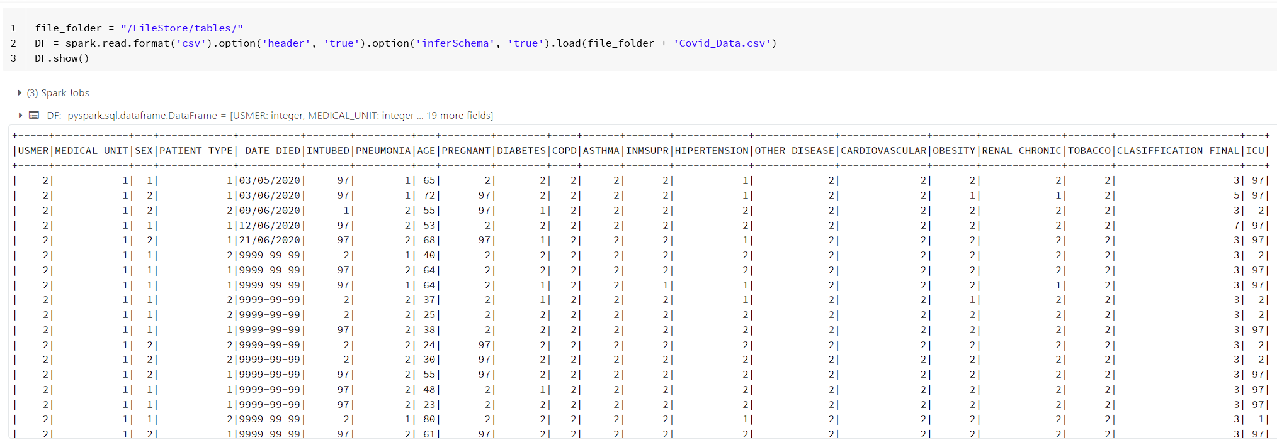
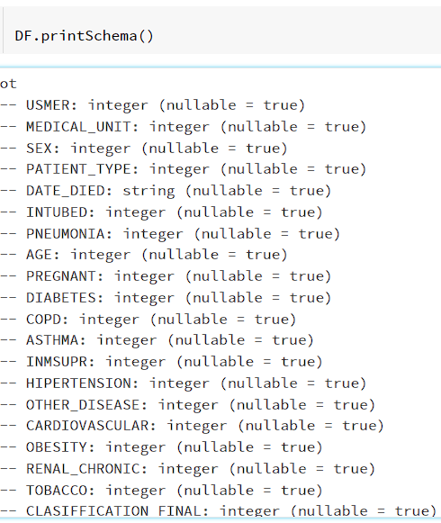
Data Exploration

Slide 8
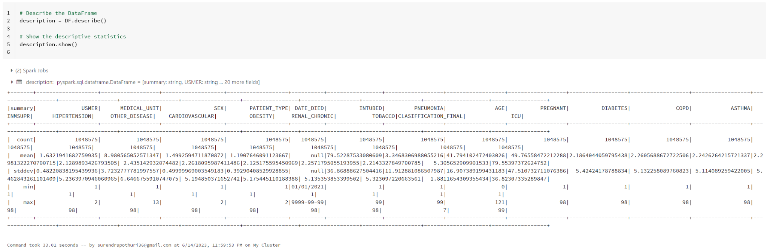
Data Exploration

Slide 9
Data Cleaning & Pre-processing
During data exploration it was found that all the categorical columns were in numerical representations.
The author of the dataset represented missing values using integers ‘97’, ‘98’ and ‘99’.
This majorly affected attributes -
INTUBED( Whether the patient was intubed or not).
PREGNANT(Whether the patient was pregnant or not).
ICU (Whether the patient was admitted into the ICU or not).
It was also found that ‘DATE_DIED’ had values representing patient is still alive by date values ‘9999-99-99’.

Slide 10
Data Cleaning & Pre-processing
Following steps were taken to handle missing information:
Where the patient’s sex was male and attribute ‘PREGNANT’ had missing values it was replaced with ‘2’ which represented ‘no’.
Columns ‘ICU’ and ‘INTUBED’ were dropped.
After the above steps incase missing values still remain in any of the attributes they were dropped except for the ‘DATE_DIED’ attribute.
Created a new attribute which represented whether patient is alive or not by values ‘2’ and ‘1’ respectively.

Slide 11
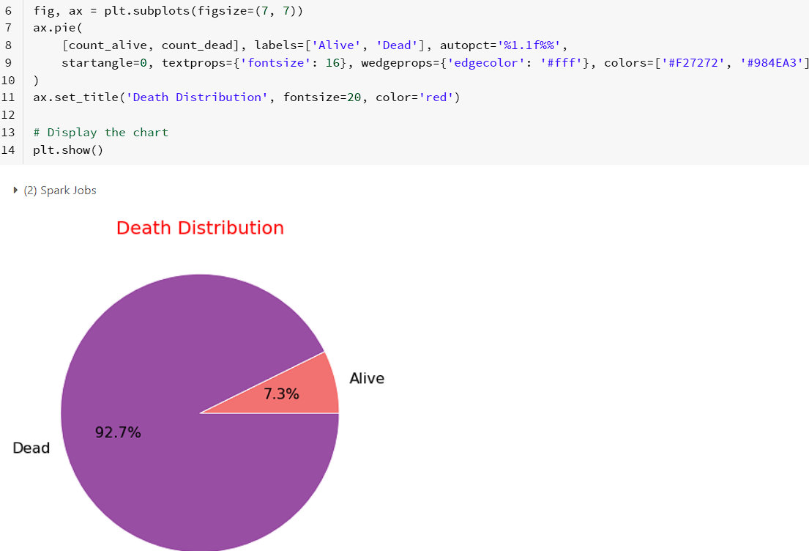
Data Visualizations
PySpark offers powerful visualization libraries like Matplotlib and Seaborn.
Matplotlib creates diverse plots: line charts, bar graphs, scatter plots.
Seaborn enhances plots aesthetically and provides additional functionalities.
Visualizations help present COVID-19 data effectively for decision-making.
Data visualization simplifies complex information, revealing patterns and correlations.

Slide 12
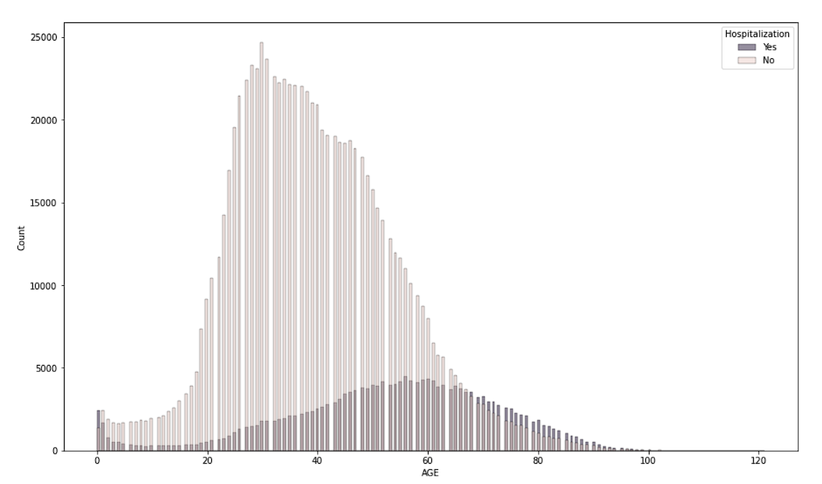
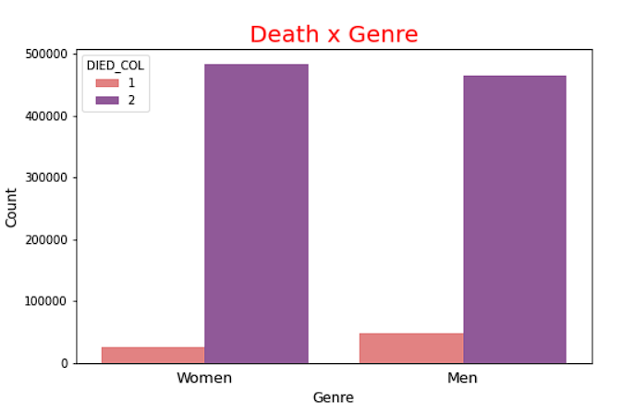
COVID-19 Trends

Slide 13
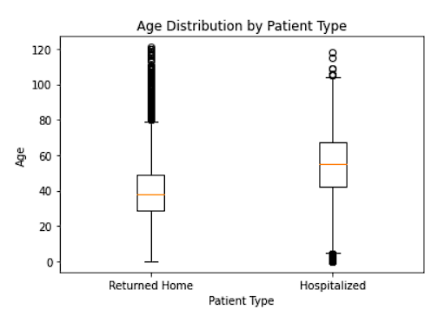
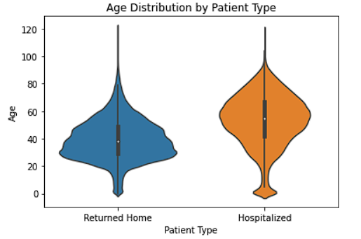
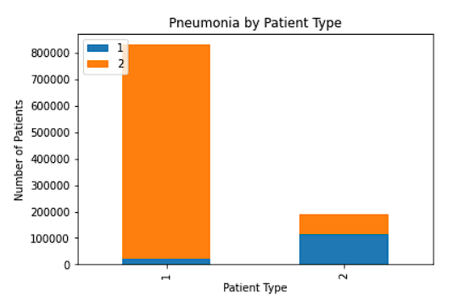
Disease Prevalence

Slide 14
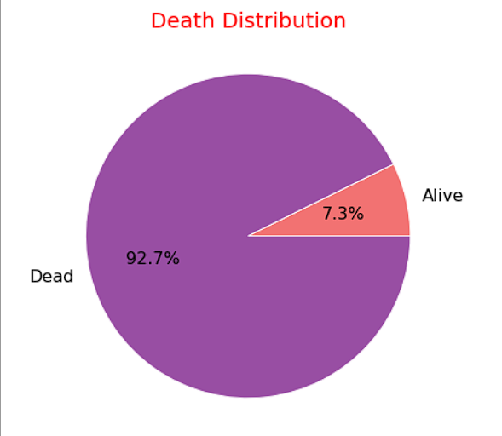
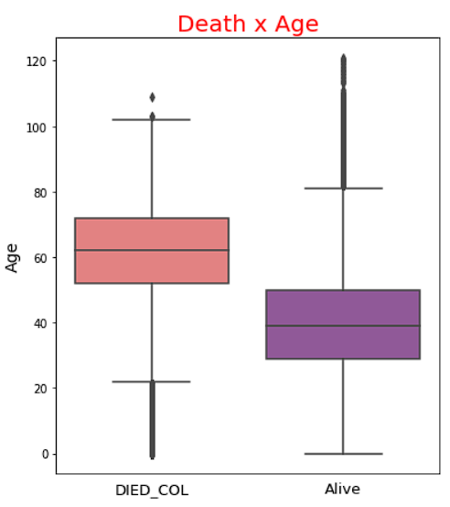
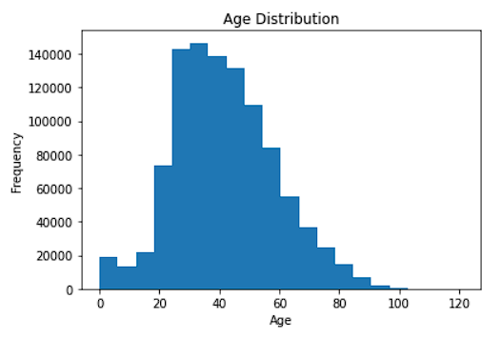
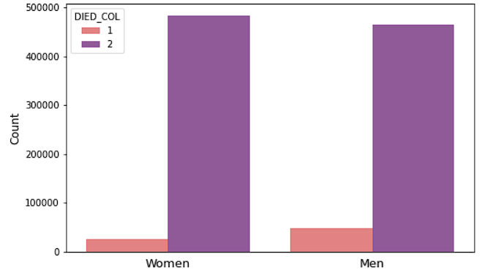
Mortality Analysis

Slide 15
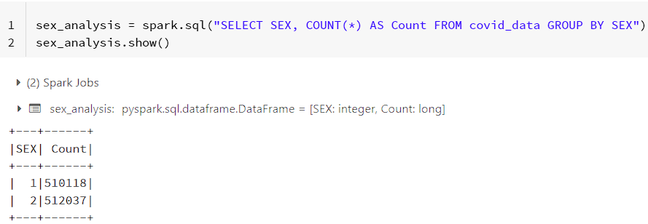
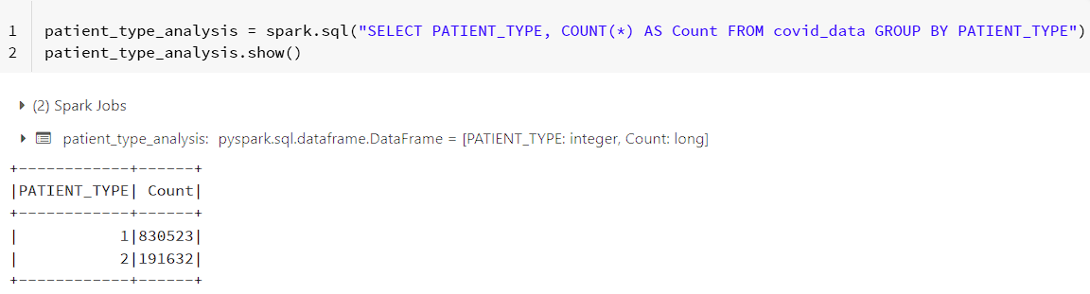
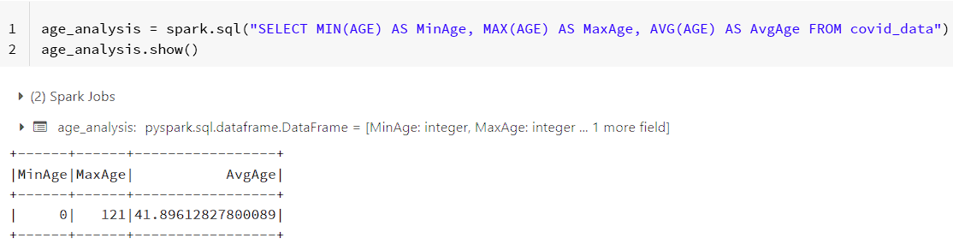
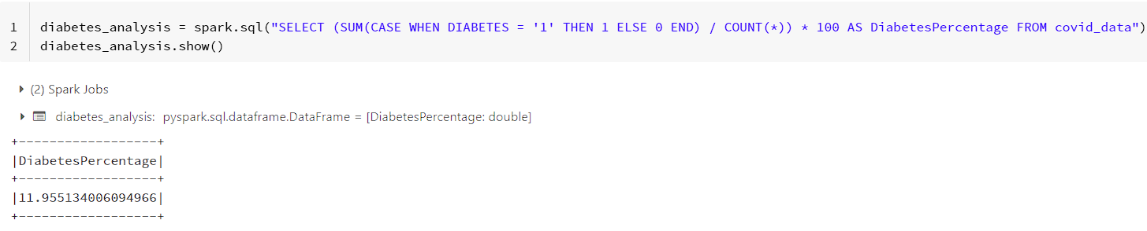
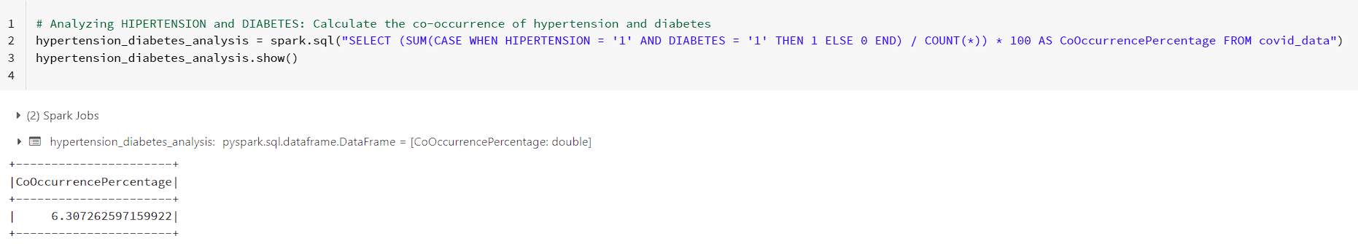
Analytics Using PySpark

Slide 16
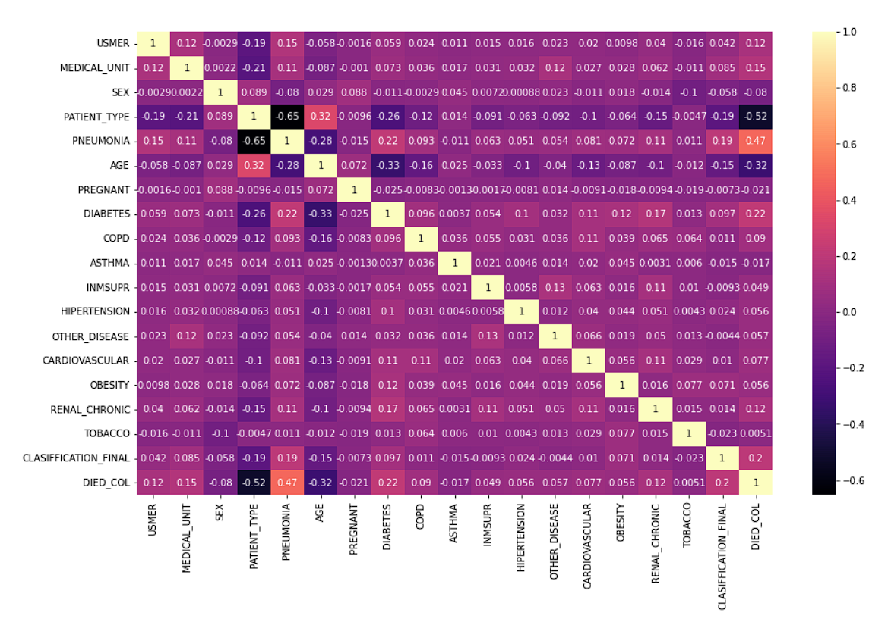
Correlation Analysis

Slide 17
COVID-19 Predictive Modeling using PySpark
Features 'AGE', 'PATIENT_TYPE', 'PNEUMONIA', 'MEDICAL_UNIT', and 'HIPERTENSION' are selected for classification.
Data is transformed using a VectorAssembler to combine the selected features into a single vector column.
The data is split into training and test sets (80% training, 20% test) with a random seed of 42.
Logistic Regression model is trained on the training set.
Accuracy of the model on the test set is evaluated and it is 93%.
The predictions of the target column 'DIED_COL' and the corresponding 'prediction' column are displayed for the top 20 rows.

Slide 18
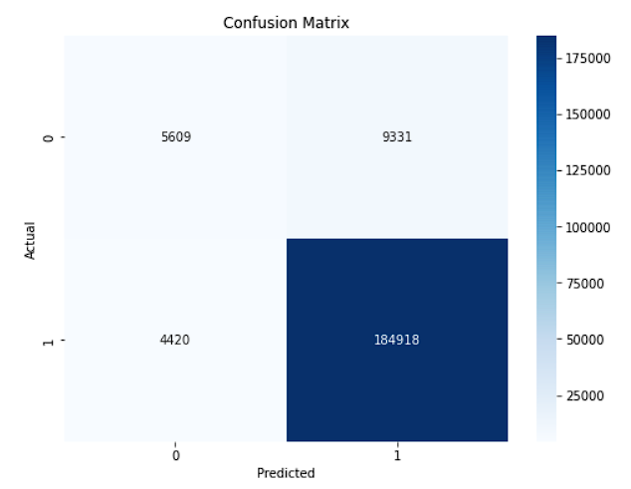
Model Evaluation
To evaluate the performance of the predictive model, the following techniques were employed:
Accuracy
Confusion Matrix
Evaluation Metrics
Heatmap Visualization
Interpretation & Decision Making

Slide 19
Collaborative Data Analysis with DataBricks
Notebooks: Interactive platform for code execution, data visualization, and documentation.
Version Control: Integration with Git for tracking changes and facilitating collaboration.
Sharing and Collaboration: Easy sharing of notebooks, code, and visualizations with team members.
Interactive Visualizations: Rich visualizations for collaborative data exploration.
Integrated Development Environment (IDE): Unified workspace for streamlined collaboration.

Slide 20
Data Governance & Security
Importance of Data Governance: Ensures data accuracy, integrity, privacy, and compliance with regulations.
Security Concerns: Protecting sensitive health data, preventing unauthorized access, and ensuring data confidentiality.
Databricks' Approach: Provides robust security measures, including encryption, access controls, and audit logs.
Data Protection: Databricks implements data protection mechanisms to safeguard COVID-19 data throughout its lifecycle.
Compliance and Regulation: Databricks helps organizations adhere to data protection regulations such as HIPAA and GDPR, ensuring proper handling of COVID-19 data.

Slide 21
Challenges & Limitations
Data Quality
Data Privacy
Computational Resources
Data Integration
Data Interpretation & Context
Resource Constraints

Slide 22
Best Practices
Efficient Coding
Performance Optimization
Reproducibility
Data Validation and Cleaning
Scalability and Parallelization
Code Optimization

Slide 23
Conclusion
Data analysis is vital in the fight against the COVID-19 pandemic.
Databricks and PySpark provide powerful tools for analyzing large-scale COVID-19 datasets.
Collaborative features like notebooks, version control, and sharing in Databricks facilitate effective teamwork and knowledge sharing.
Data governance and security are essential in COVID-19 data analysis, and Databricks addresses these concerns.
Challenges include data quality, privacy, and the need for computational resources.
Best practices for COVID-19 data analysis with Databricks and PySpark include efficient coding, performance optimization, and reproducibility.
Overall, data analysis empowers us to better understand and combat the COVID-19 pandemic. Leveraging Databricks and PySpark enhances our capabilities in this endeavor.

Slide 24
Useful Links & References
https://www.databricks.com/glossary/big-data-analytics
https://docs.databricks.com/exploratory-data-analysis/index.html
https://towardsdatascience.com/exploratory-data-analysis-eda-with-pyspark-on-databricks-e8d6529626b1
Dataset Link:
https://www.kaggle.com/datasets/meirnizri/covid19-dataset

Slide 25
Questions?

Slide 26
Thank You!

